Slide 1
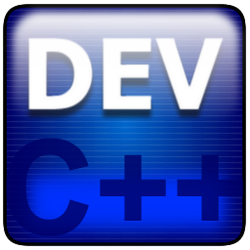
Project 3
Team MUDE
By James Denesha and Cedric Mulumba

Slide 2
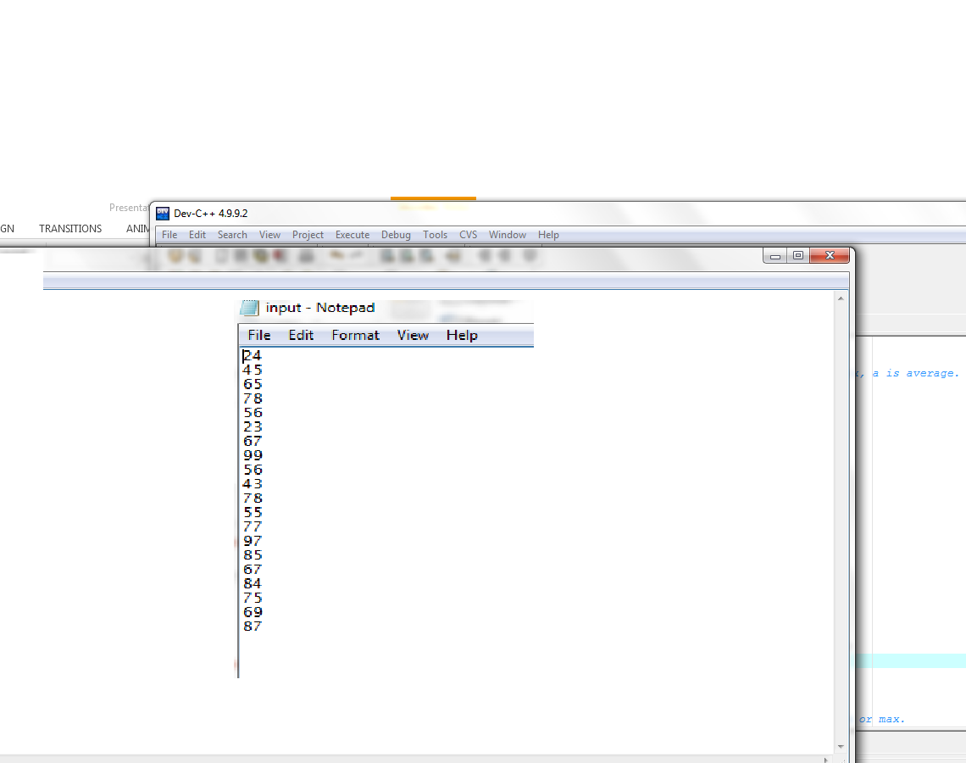
Testing Input
This is our input of data from a .txt file.
Input was put on individual lines to match output through command prompt.

Slide 3
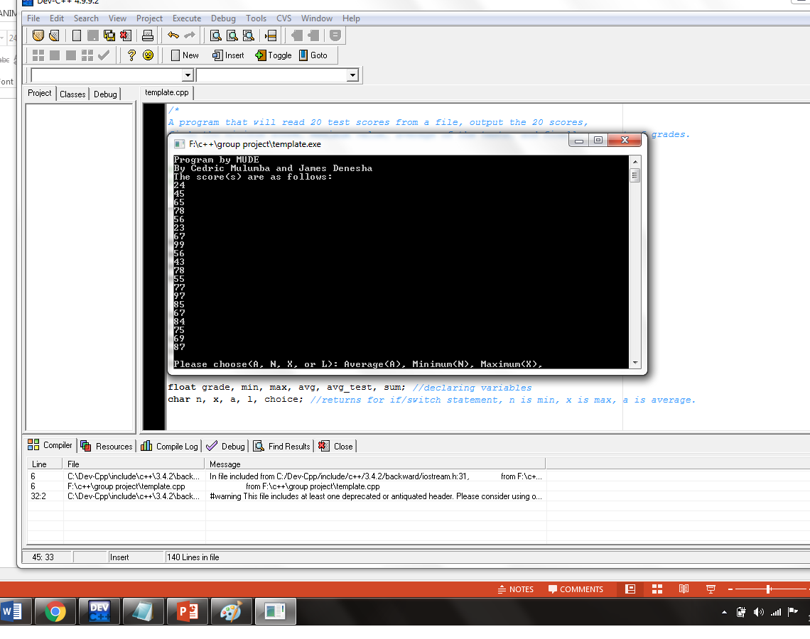
Testing Output
Output through command prompt.
Output first has our team name followed by an array filled from the input file.

Slide 4
Things Learned(Cedric)
Writing C++ statement based on a certain logical.
Inputting and outputting data.
Using math calculation to output the void functions.
Creating loop and function (void and return).

Slide 5
Things Learned(James)
Passing arrays to functions.
Using arrays inside of functions using “for”, “if” , and other commands.
Being more precise with “if” loops using multiple parameters.
Ex: else if ((grades_array[i] >= 80) && (grades_array[i] <= 89 ))

Slide 6
Conflicts
Who will do what work?
Who has time to do what?
Communication (When both of us were working/busy)
How to organize the c++ file/working with partners code.

Slide 7
Resolutions
Split up the work evenly.
Coordination: when one of us wasn’t at work, they would have something to do for the project.
Decided to let one person organize the main file to keep it neat.

Slide 8
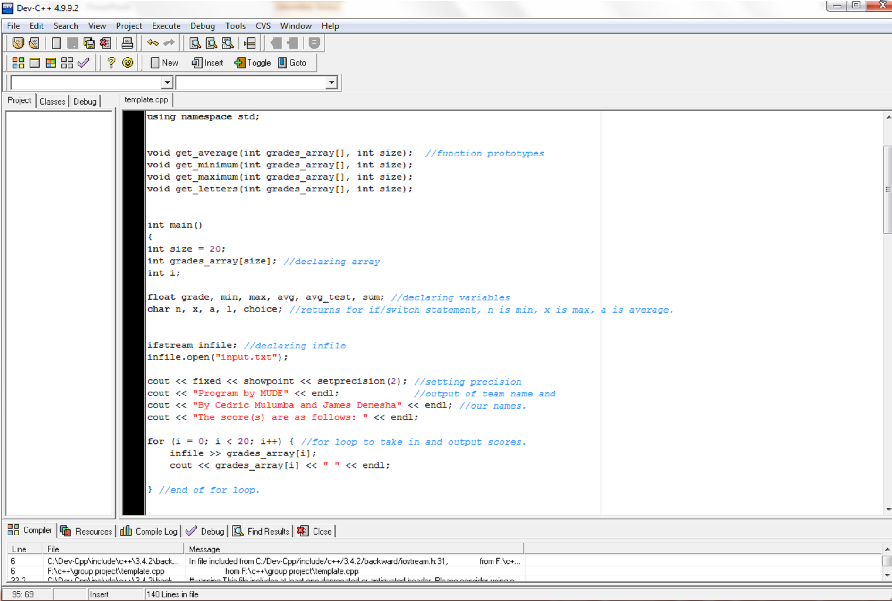
Working Program

Slide 9
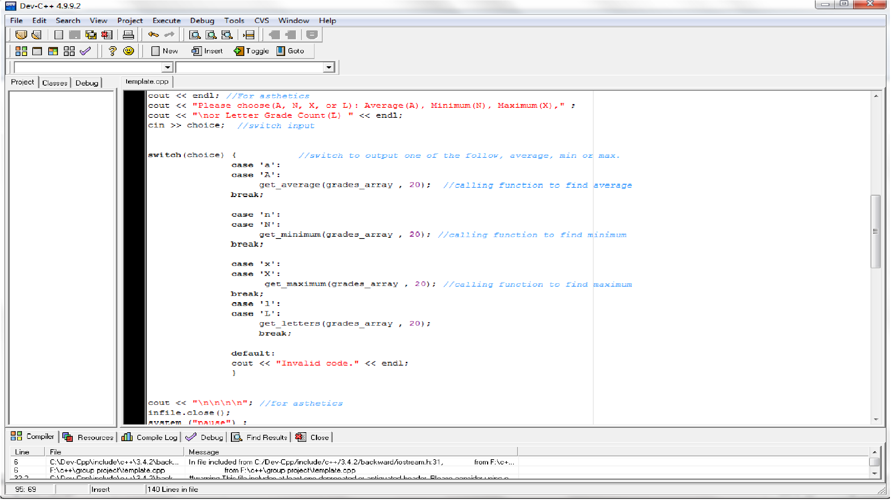
Continued

Slide 10
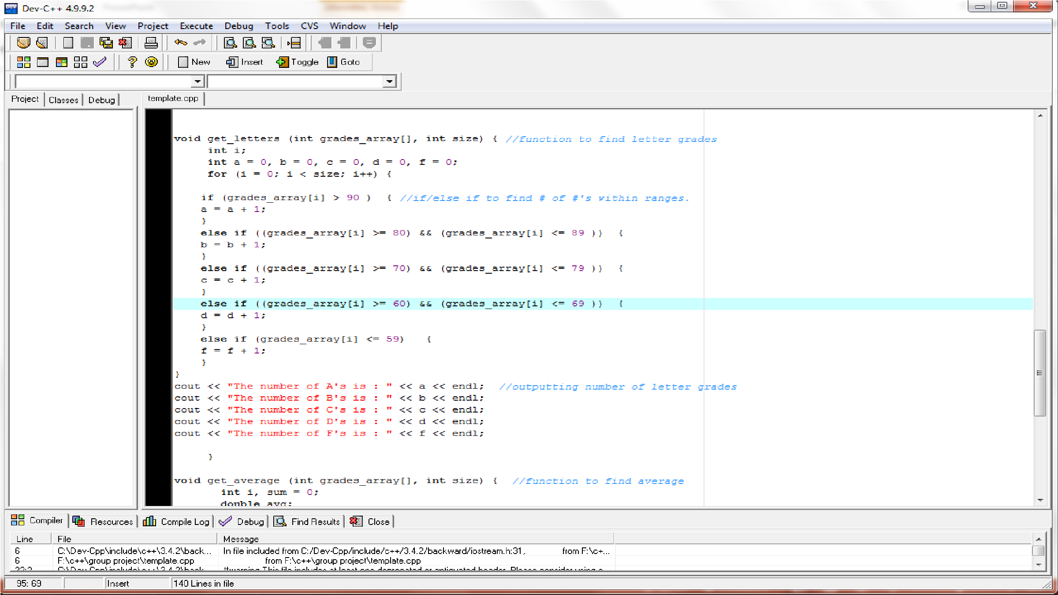
Continued(Letter Grade Function)

Slide 11
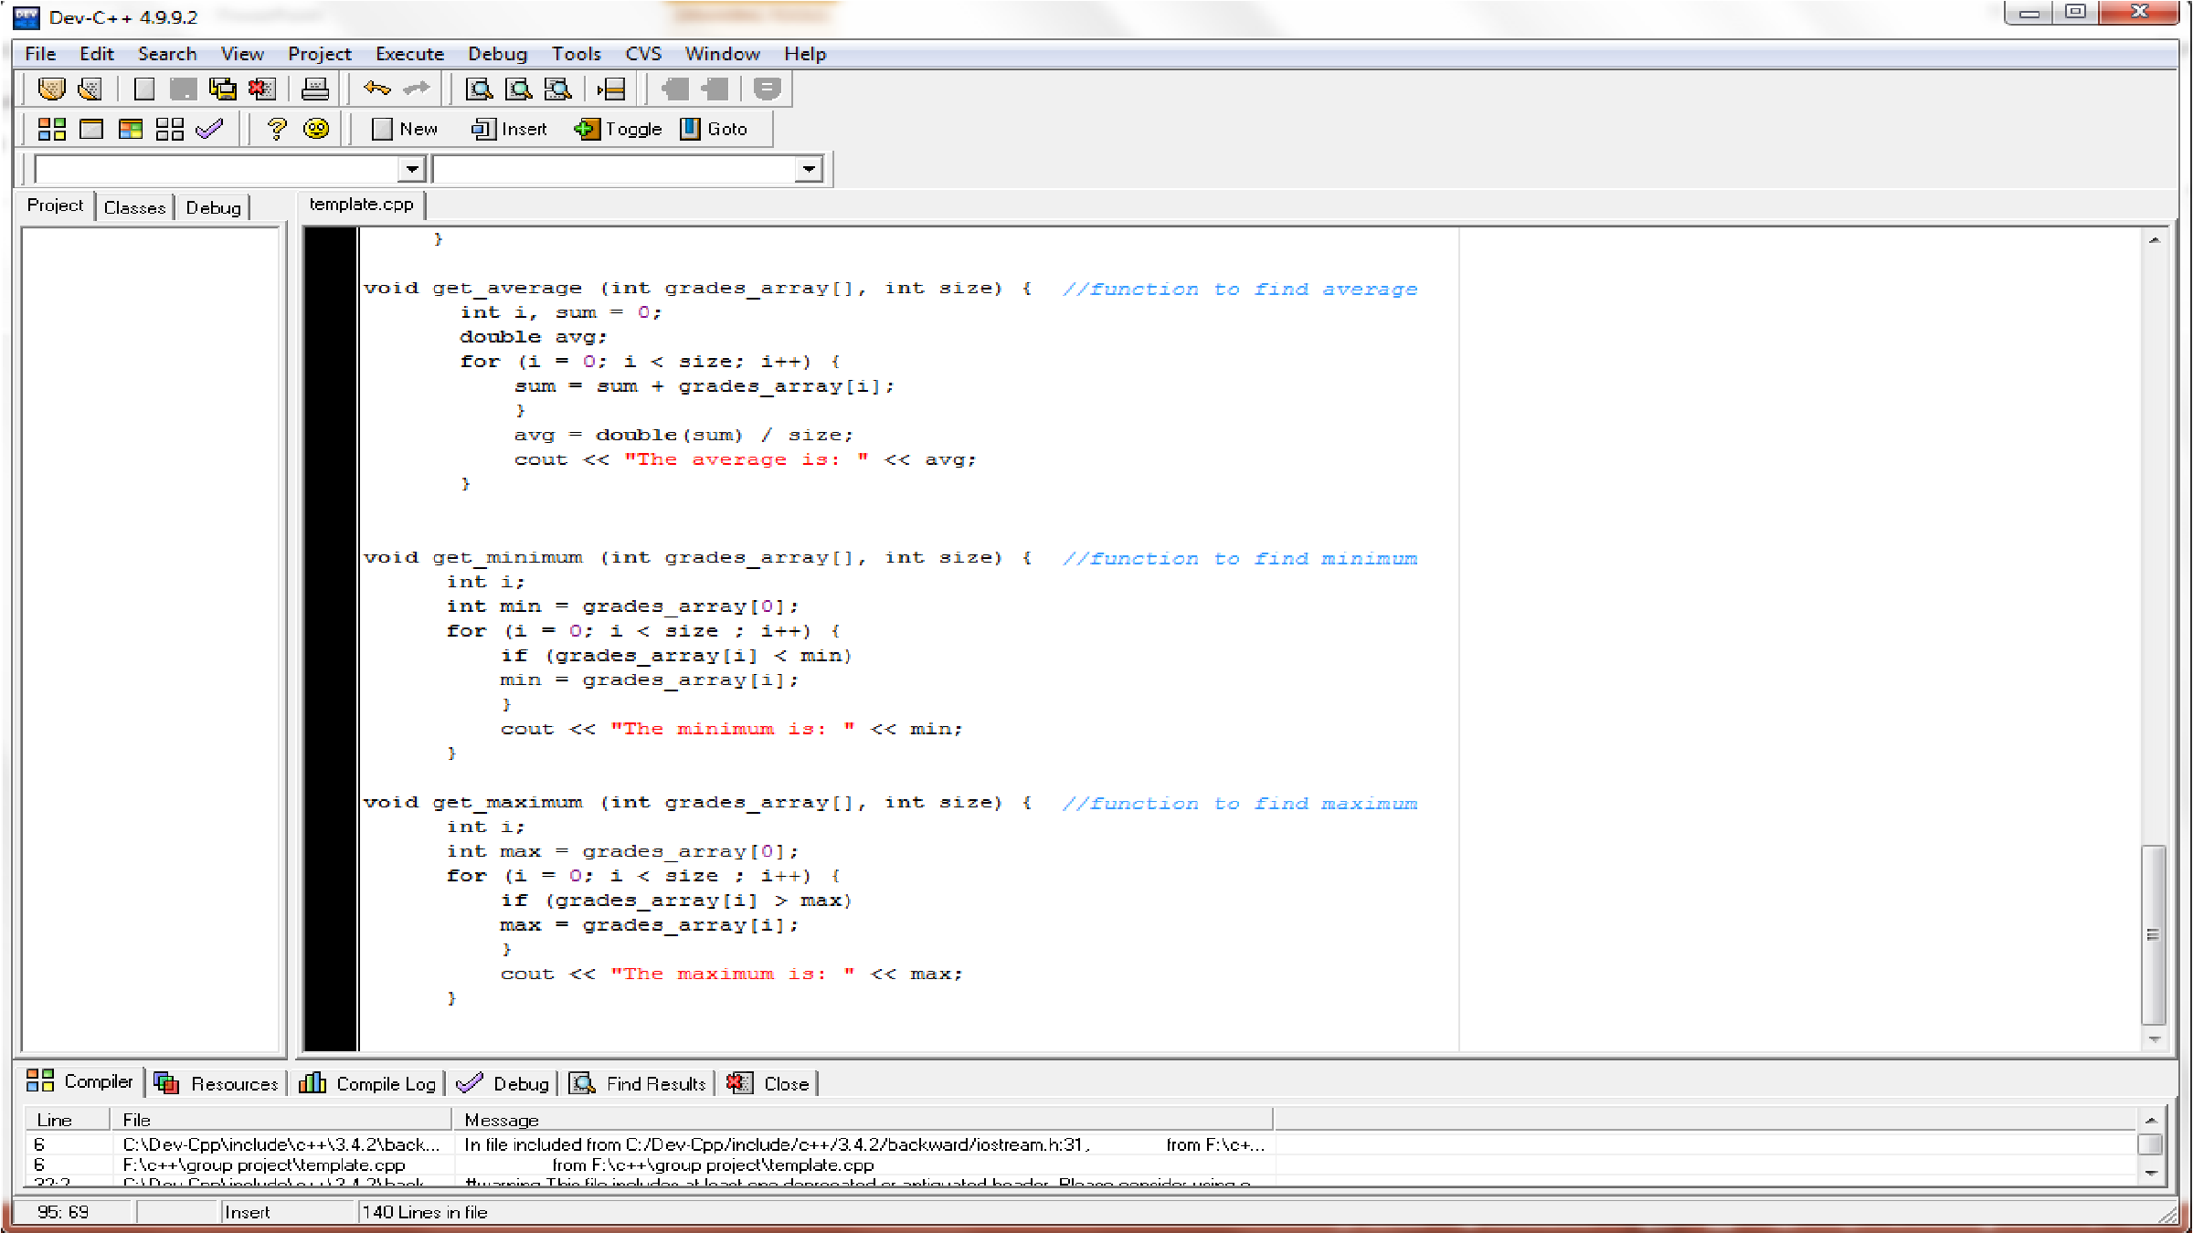
Continued(min/max/average functions)

Slide 12
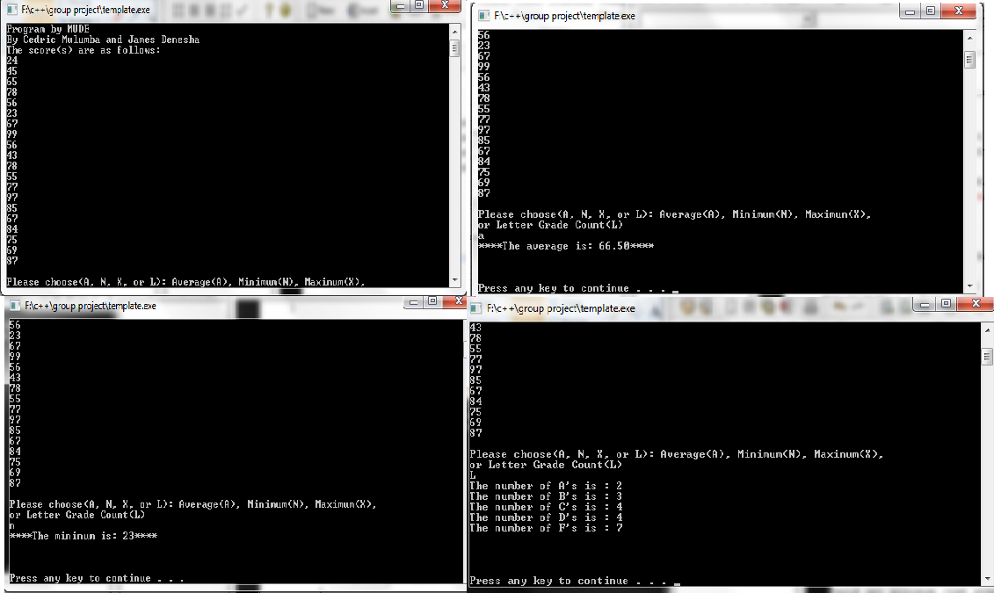
What it looks like.

